Slide 1

Omni - Phase: Two
Software Quality Assurance & Testing Report
Presenting the results of our comprehensive testing phase for the CleanCity Waste Scheduler application.
Erick Omondi
Henok Girma
Test Manager
Risk Analyst
Lydia Awuor
Test Executor

Slide 2
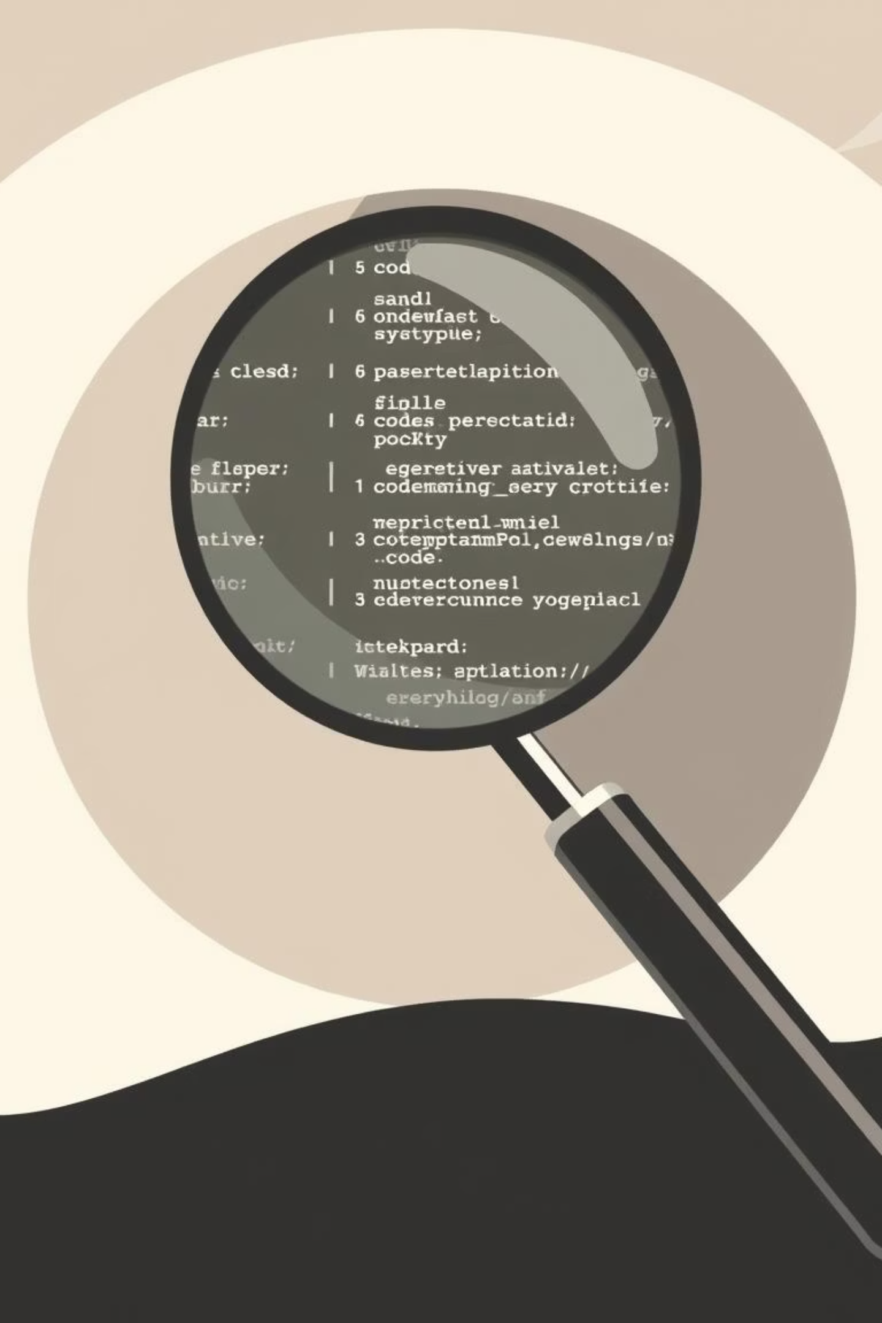

Comprehensive Test Case Execution
During the testing of the CleanCity Waste Scheduler web application, we designed and executed 70+ detailed test cases to assess the system's core aspects:
70+
Total Test Cases
Functionality and Feature Verification
Usability and User Experience
Our focus was to ensure that all core features worked as expected and that user interactions produced accurate and consistent results across all modules of the application.
Reliability and Performance Under Load
The rigorous testing process aimed to minimize post-launch defects and enhance overall software stability, focusing on high-risk areas like scheduling and user authentication.

Slide 3
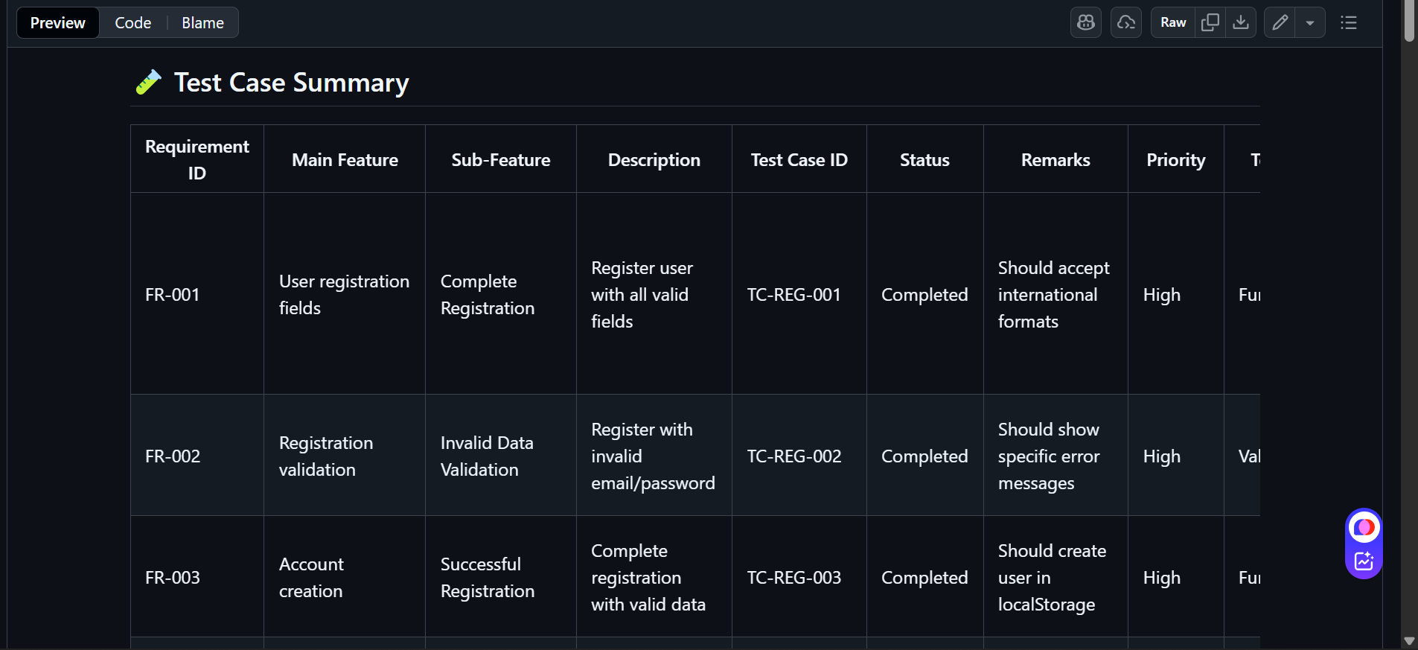
Detailed Test Case Documentation
Traceability and Execution Status
Structured Approach
All 70+ test cases were meticulously documented, outlining preconditions, steps, expected results, and actual results for clear validation.
Execution Summary
The attached screenshot provides a snapshot of the test case execution log, demonstrating successful completion and passing statuses for the verified scenarios.
This documentation ensures full traceability between requirements and tested outcomes, forming the foundation of our QA sign-off.

Slide 4




Introducing Automation: Selenium Script for Login
Efficiency in Verification
Launch App
We developed a Selenium automation script specifically targeting the CleanCity web application's login flow.
Input Credentials
The script efficiently:
Opens the web application interface.
Validate Login
Enters valid user credentials.
Verifies successful access and authentication.
This successful demonstration shows how automation can quickly and accurately verify critical processes like user login, paving the way for expanded regression testing.

Slide 5
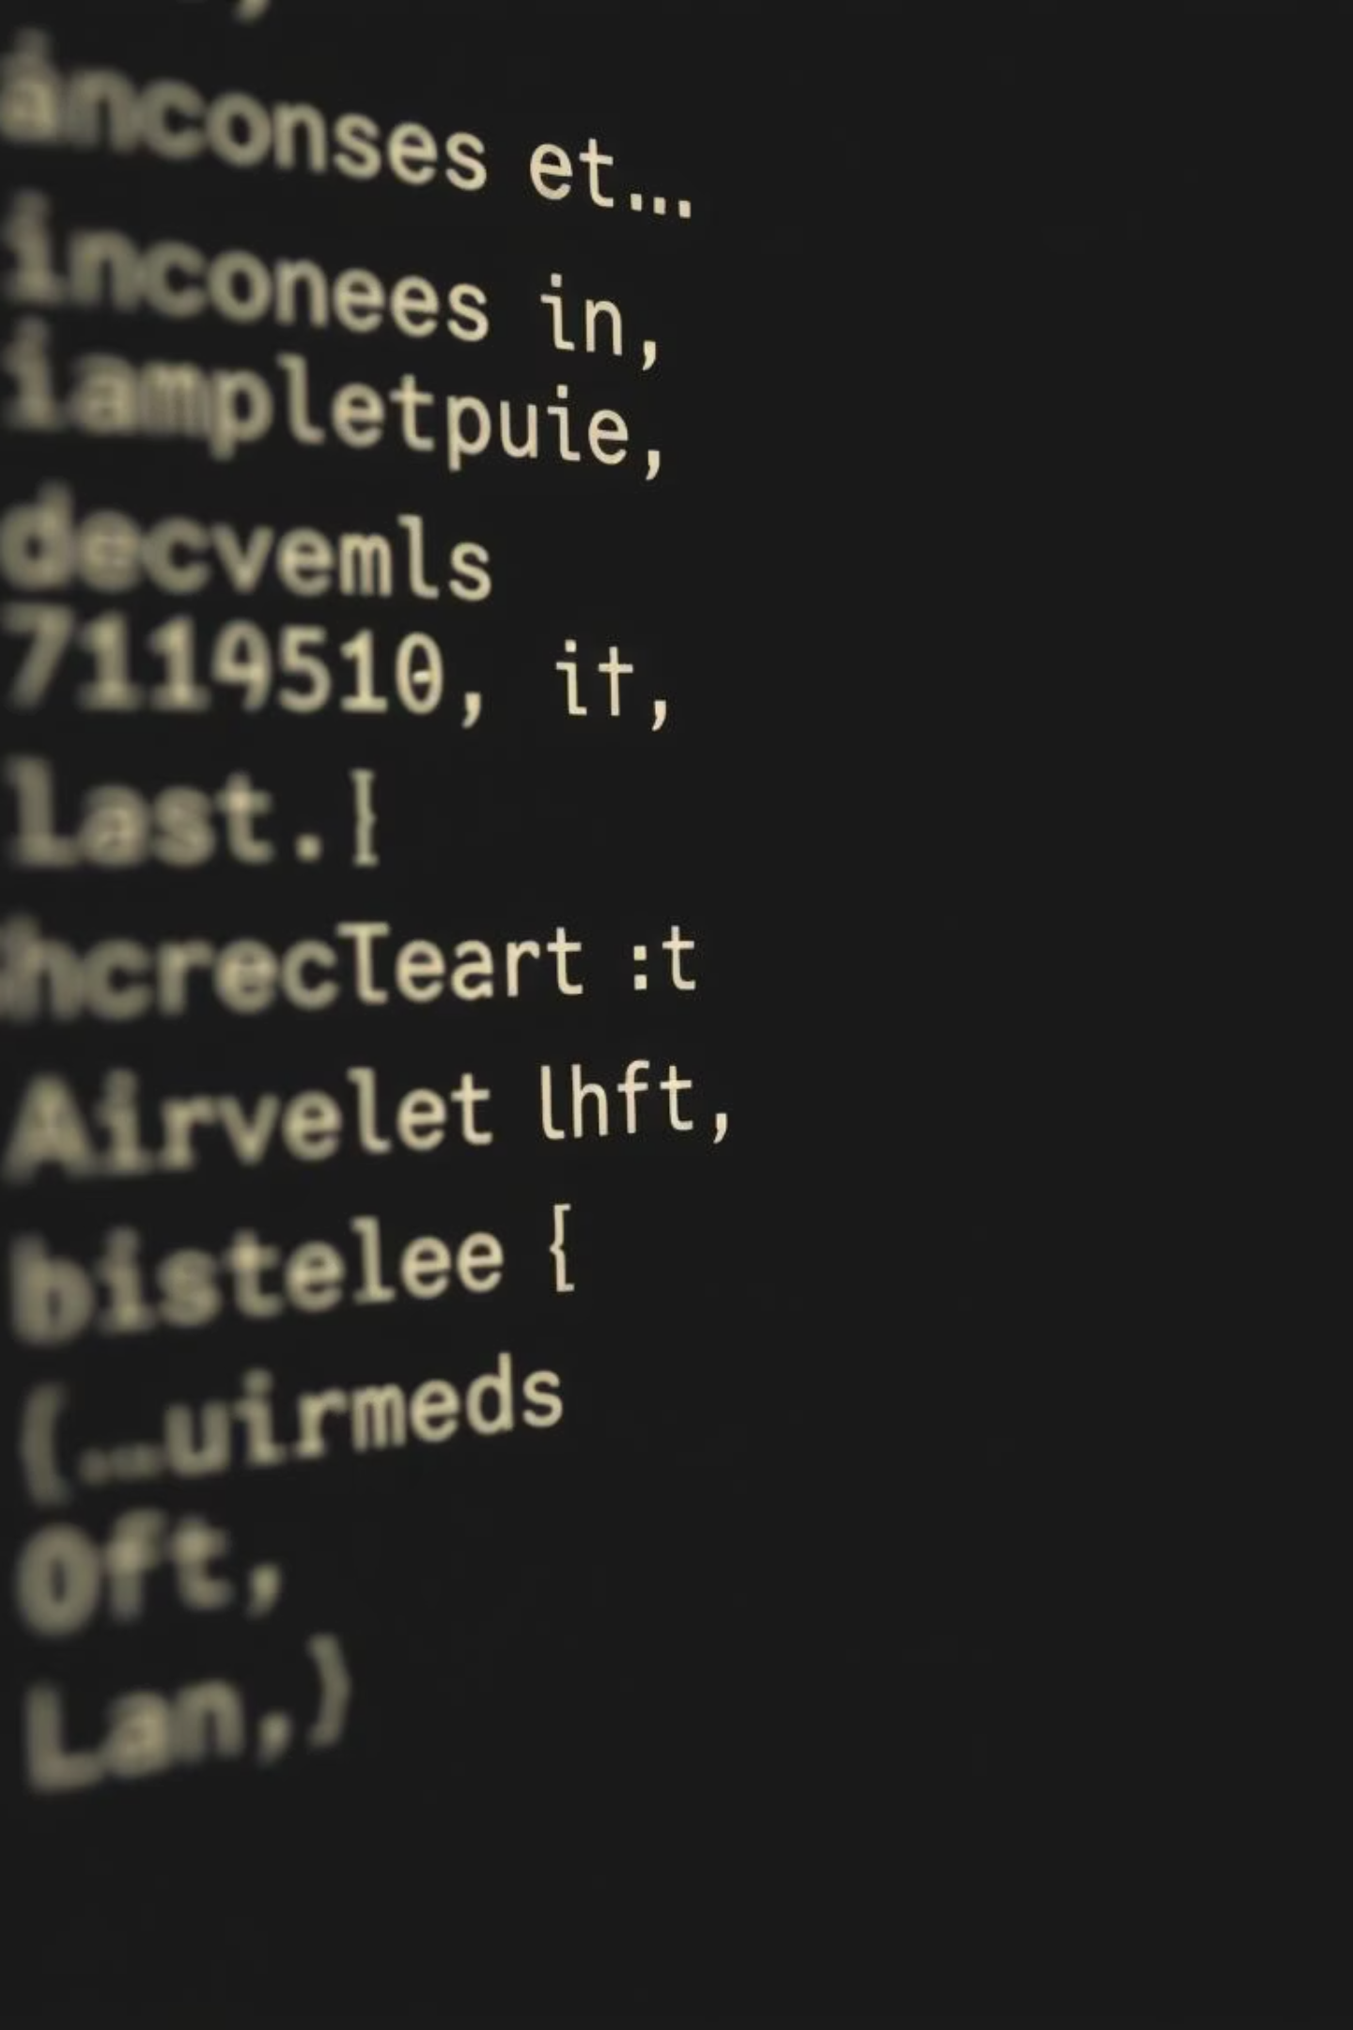
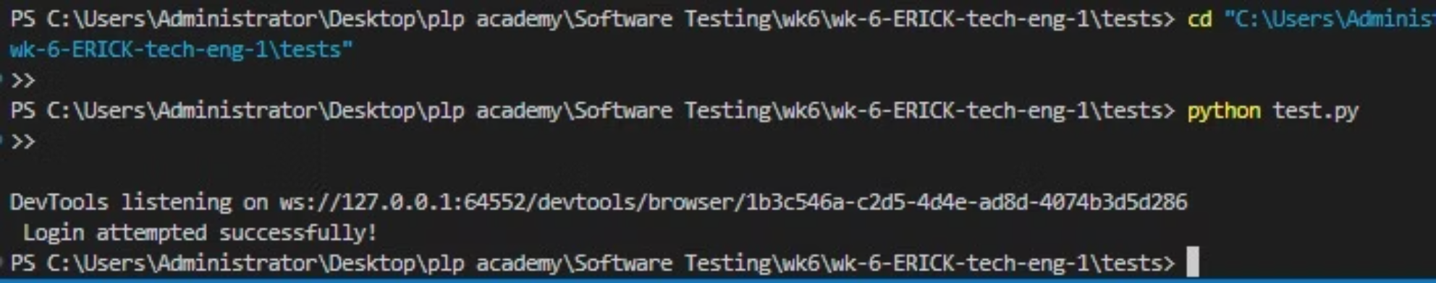
Automation Attachment: Script Execution Snapshot
The following visual confirms the successful execution of our Selenium automation script, focusing on the critical login step.
The automated test completed without errors, confirming the stability and functionality of the user authentication module under simulated user interaction.

Slide 6
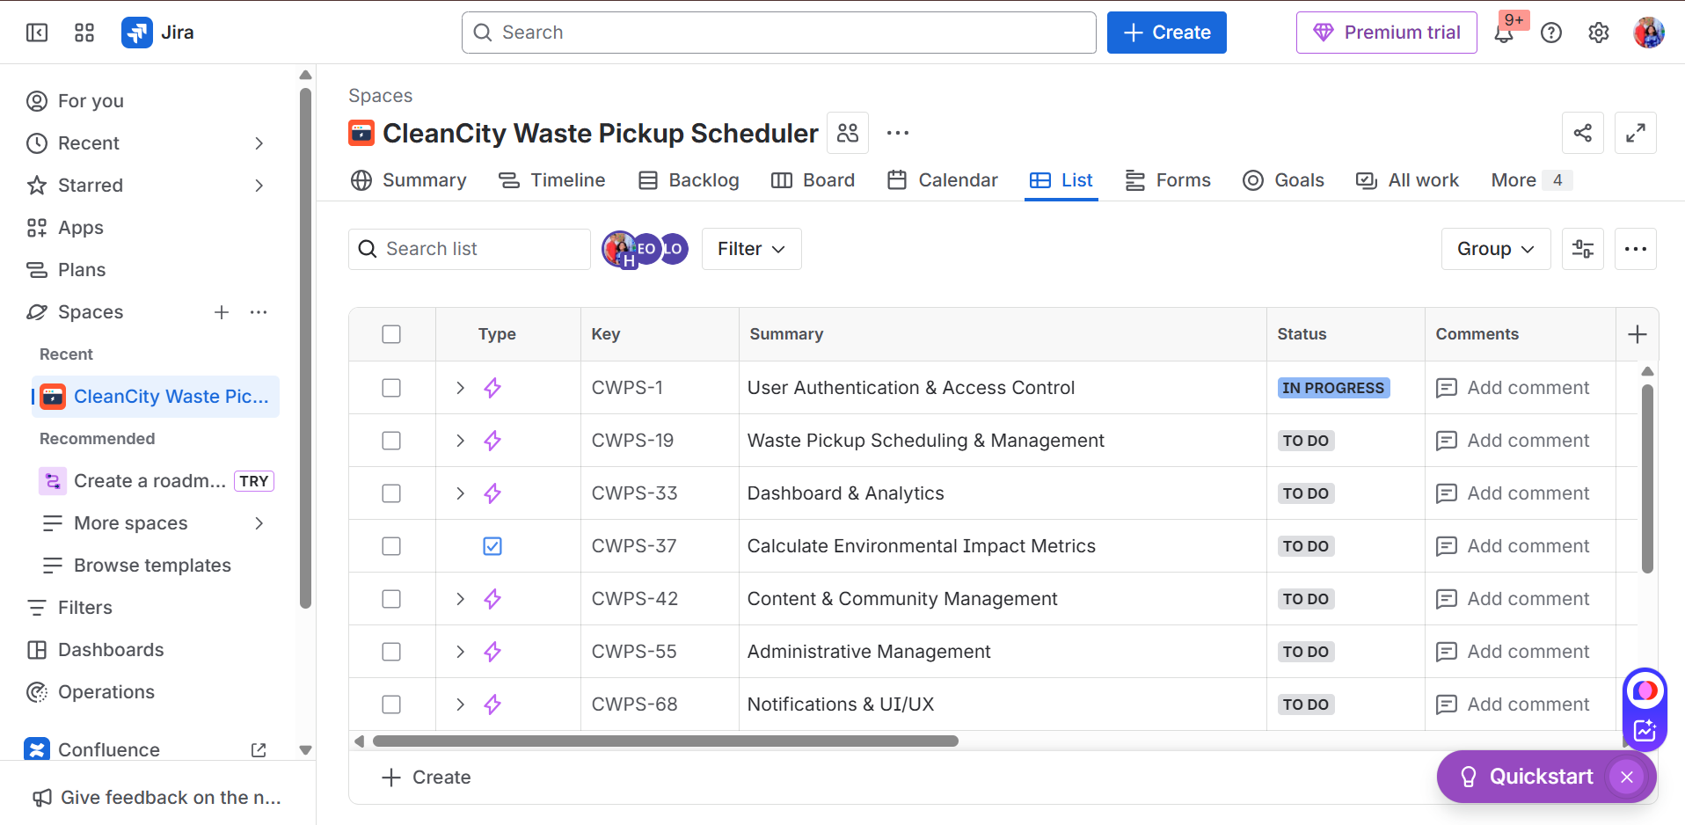
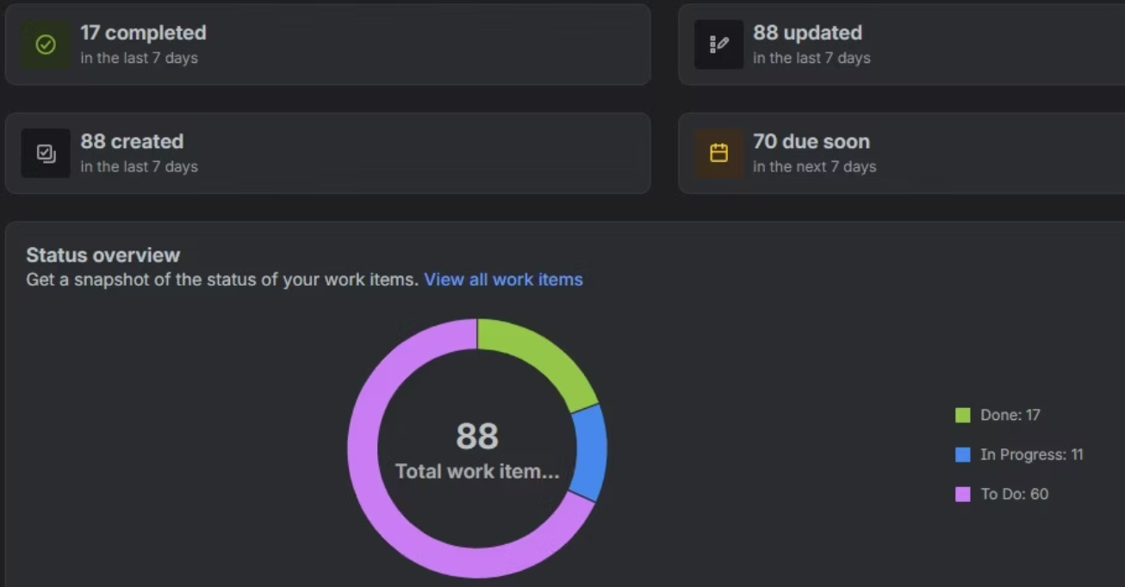



Issue Tracking and Resolution: Jira Summary
We utilized Jira for comprehensive tracking of all identified issues, defects, and tasks during the testing cycle. The summary provides a clear overview of the team's progress:
Defect Visibility
Workflow Management
Ensuring every bug is logged with high detail for rapid developer resolution.
Tracking issues through their entire lifecycle, from Open to Verified.
Risk Mitigation
Prioritizing critical and major issues for immediate attention and fix verification.

